Slide 1



AUTODORM

Slide 2

TABLE OF CONTENTS
01.
Our team
02.
Our mission
03.
Work progress
04.
Programs we used

Slide 3

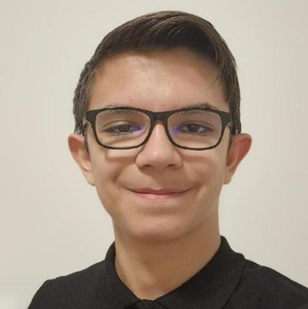

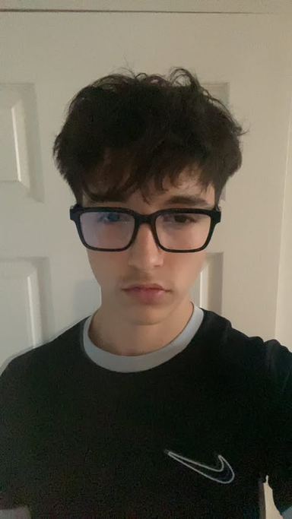

1. OUR TEAM
Antonio Ivanov
Ivan Lapchev
Beray Nuri
Georgi Gakev
Scrum Trainer
Developer
Developer
Designer

Slide 4

2. MISSION
AutoDorm is an innovative platform created to make renting a car easier. Our platform is aimed at people of all abilities. We have cars for people who want to drive in the city, and we have cars for the higher class.

Slide 5

3. WORK PROGRESS
20.04 - 26.04 | 27.04 - 03.05 | 04.05 - 11.05
75
29
21

Slide 6








4. PROGRAMS WE USED

Slide 7
THANK YOU
LES'T CONTINUE TO THE DEMO

